Slide 1
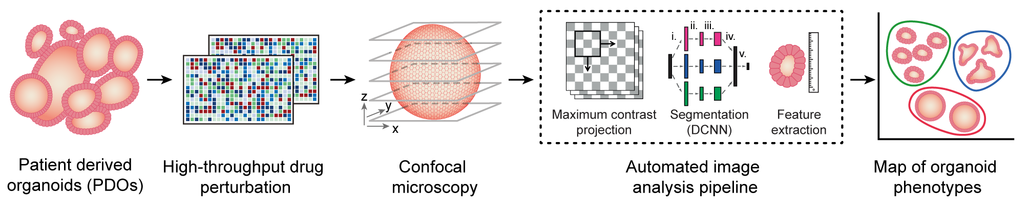
WP3 High-dimensional profiling of drug effects in organoids
Ongoing / next steps:
optimize image-based profiling method for single-cell recognition (within and outside of organoid)
build v1 benchmarking dataset (from WP1/2) with biologically relevant endpoint

Slide 2
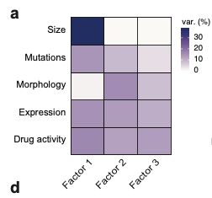
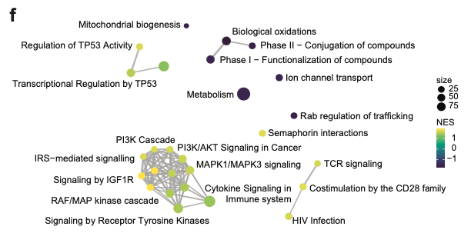
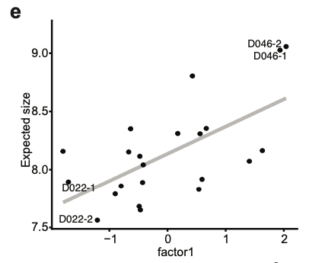
WP3 Integrating multiple biological data modalities to understand organoid phenotype profiles
Group factor analysis enables us to integrate various modalities and score organoids across a set of multi-omics factors
We discovered multiple biological programs, for example, links between IGF-signaling, organoid size and drug sensitivity towards MEK and IGFR1 inhibitors

Slide 3
WP3 Image-based profiling of organoid – PBMC engagement
Liquid handling platform test with following conditions:
Library of FDA approved small molecules at 5 concentrations
PBMC state with or without cancer organoid
PBMC state with ot without hydrogel matrix
PBMC state under following media conditions
ENA +Nicotinamide (organoid optimized medium)
ENA -Nicotinamide
50% ENA/RPMI
RPMI (PBMC optimized medium)

Slide 4
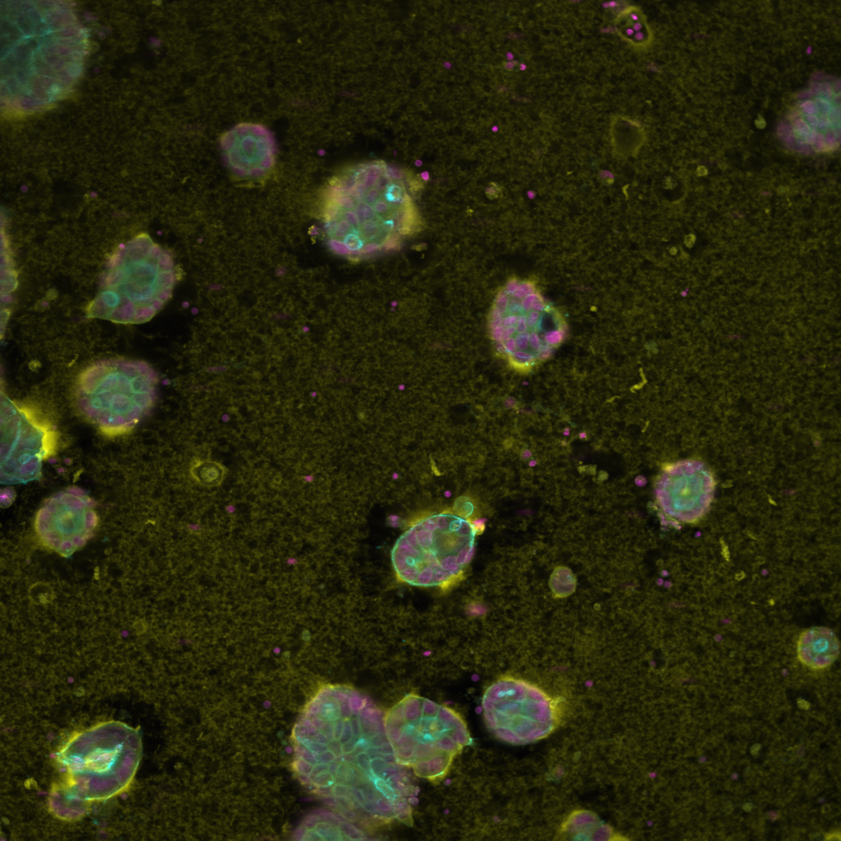
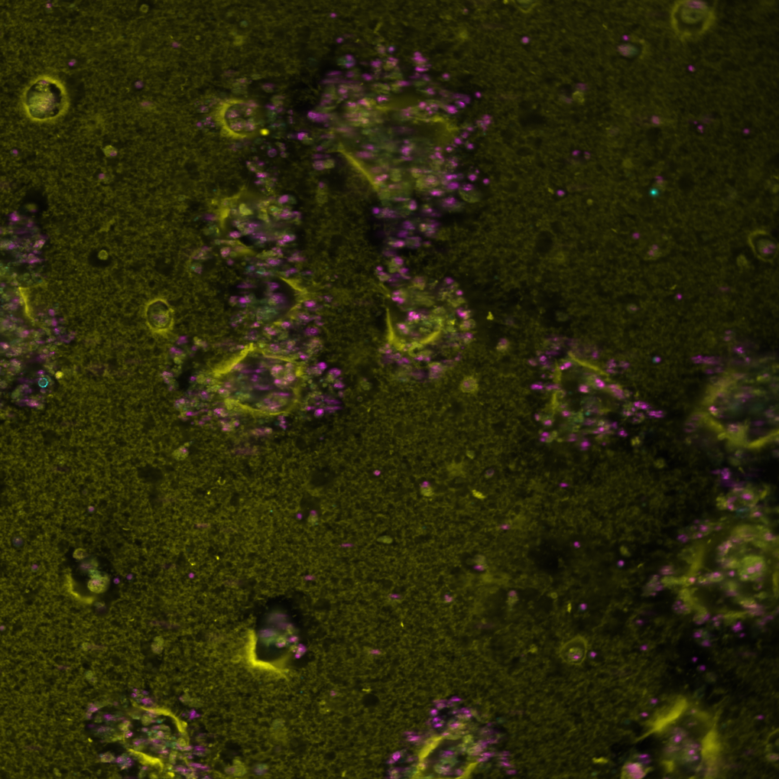
WP3 Image-based profiling of organoid – PBMC engagement
DMSO
D080 with PBMC ConA, DAPI, Phalloidin
Bortezomib
D080 with PBMC ConA, DAPI, Phalloidin

Slide 5
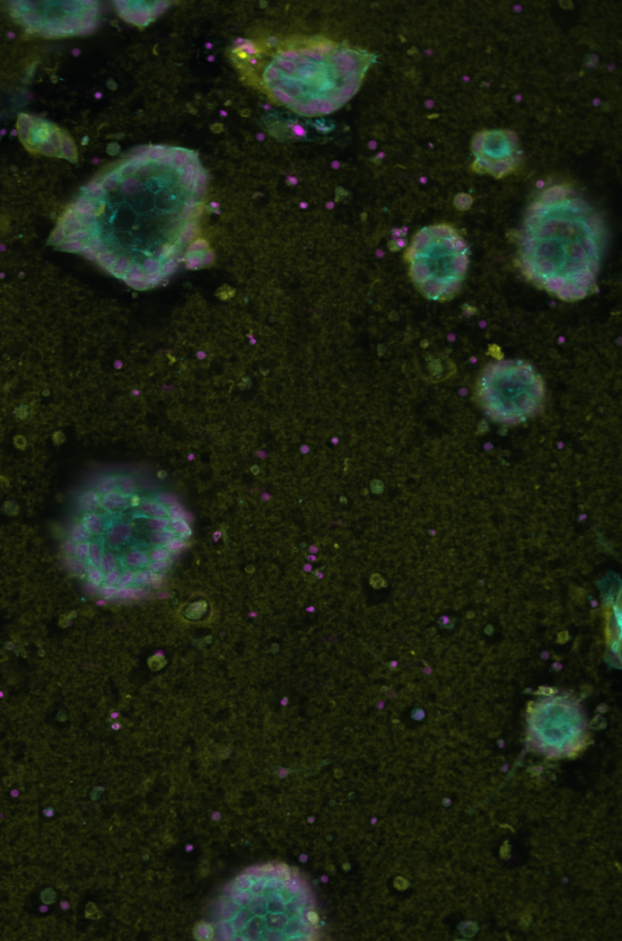

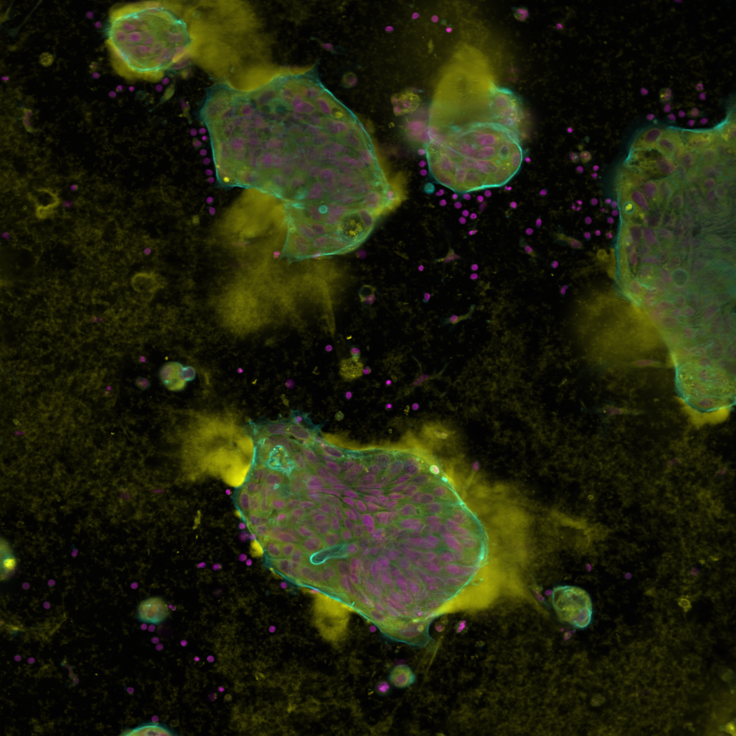
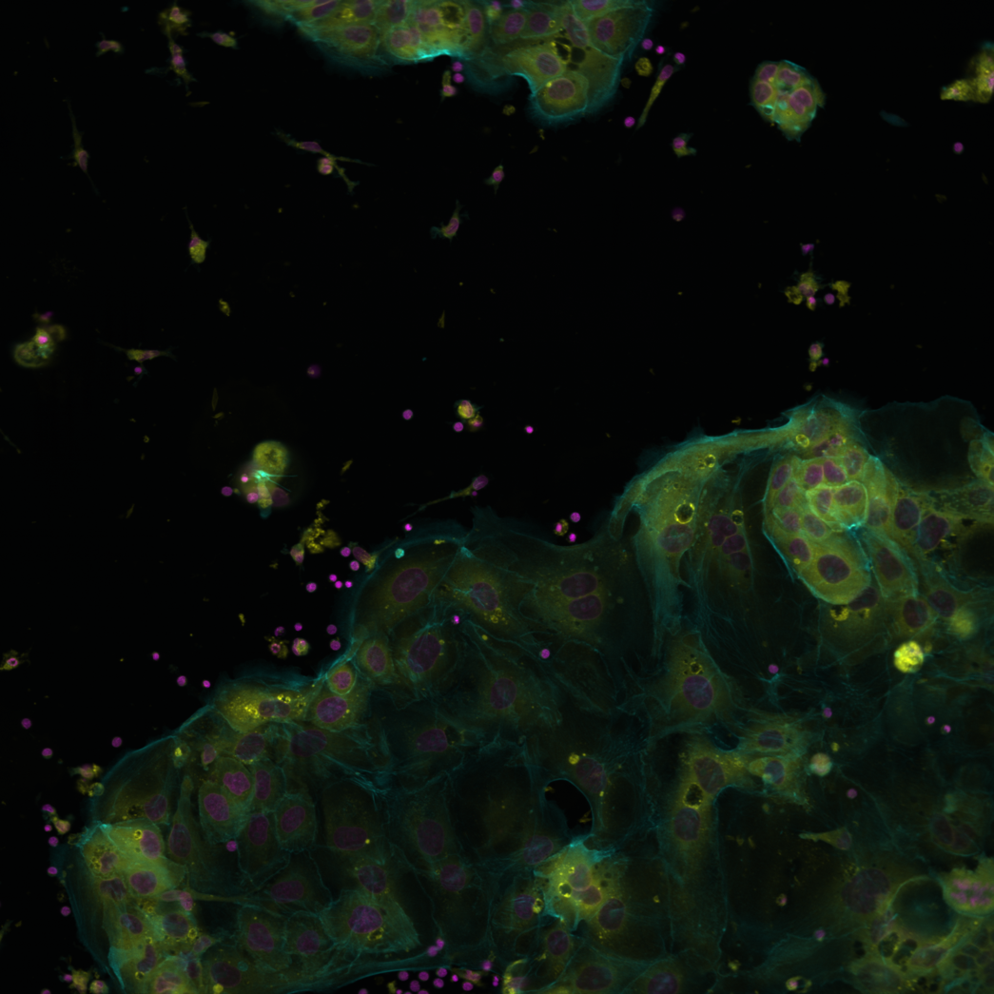
WP3 - Culture conditions have biologically significant influence on organoid growth
ENA+Nic
ENA-Nic
50% ENA-Nic / RPMI
50% ENA-Nic / RPMI
without hydrogel

Slide 6
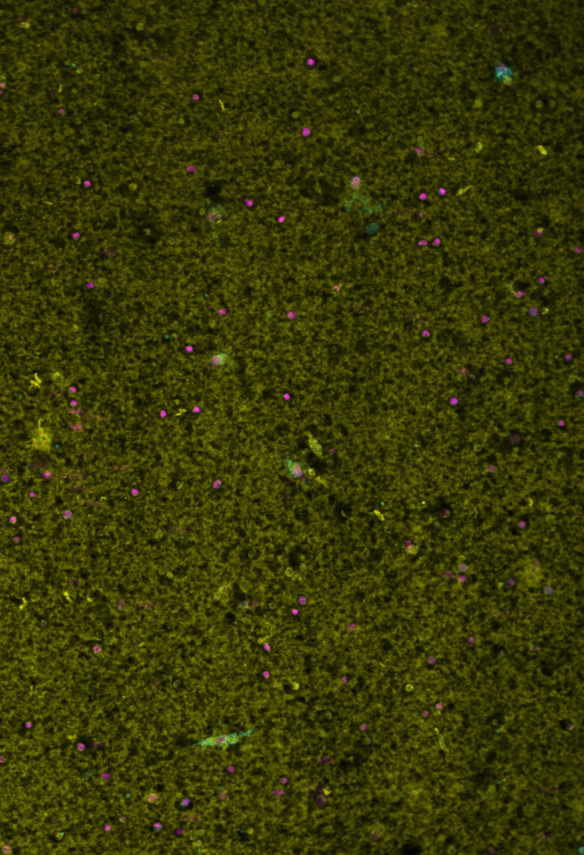
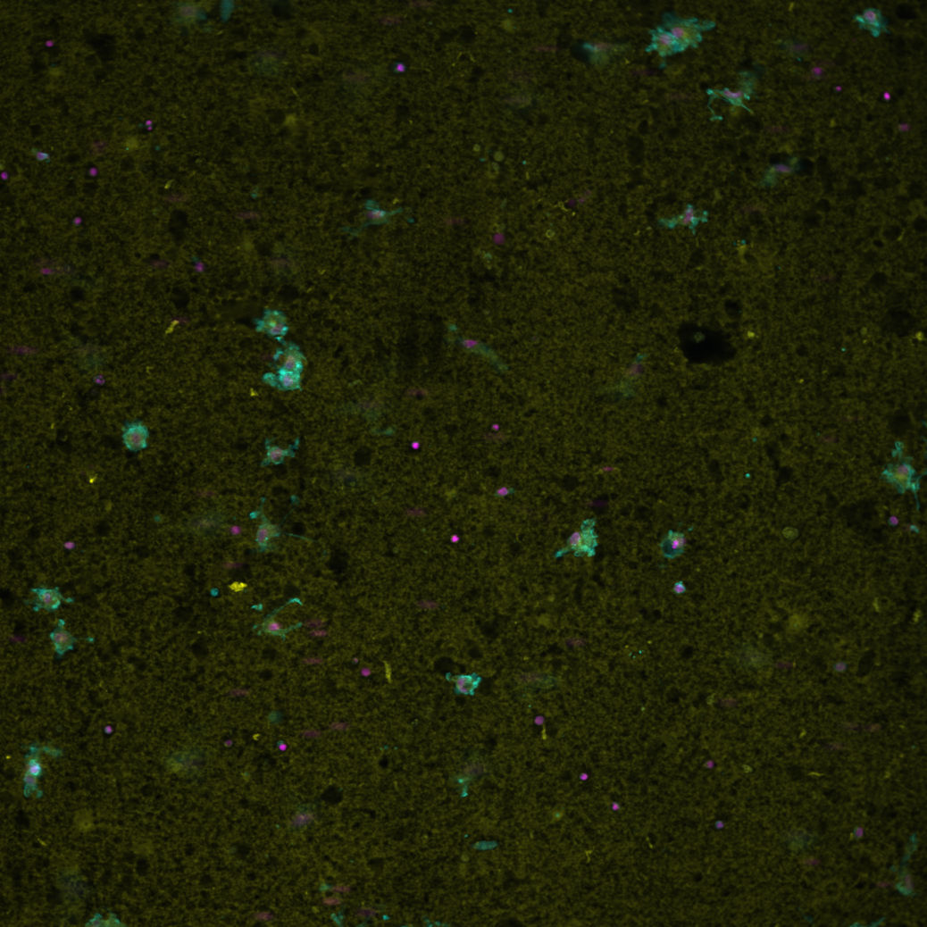
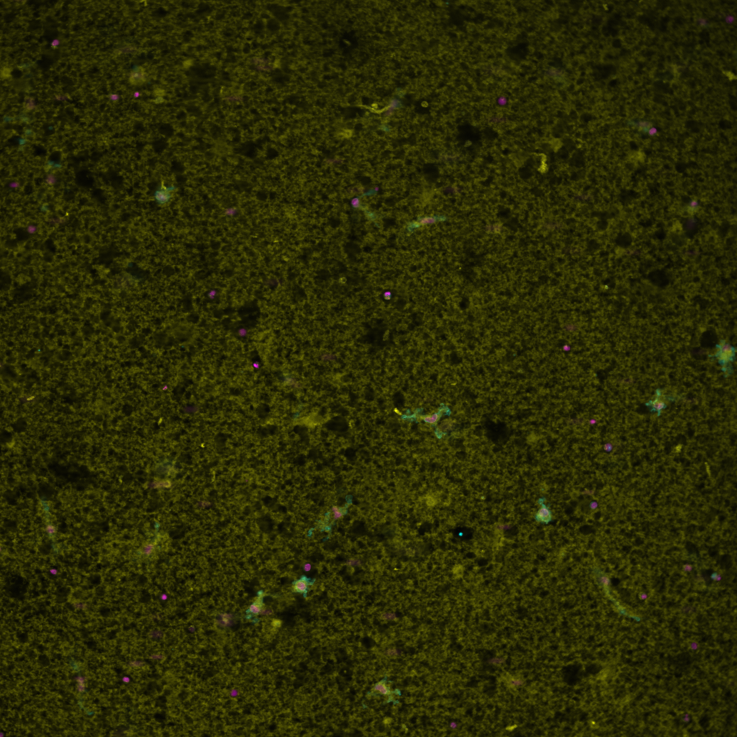
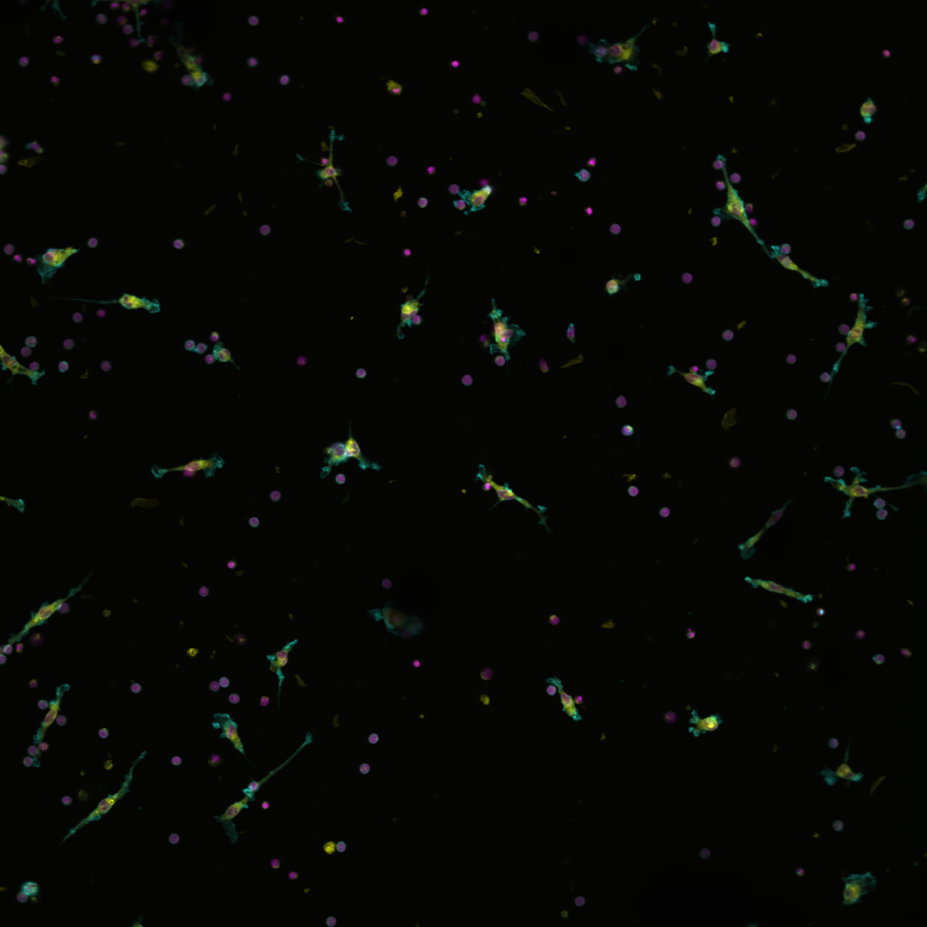
WP3 - Culture conditions have biologically significant influence on PBMC viability and state
ENA+Nic
ENA-Nic
50% ENA-Nic / RPMI
50% ENA-Nic / RPMI
without hydrogel

Slide 7
WP3 – proposed candidate conditions
50% ENA-Nic / RPMI
50% ENA-Nic / RPMI
without hydrogel

Slide 8
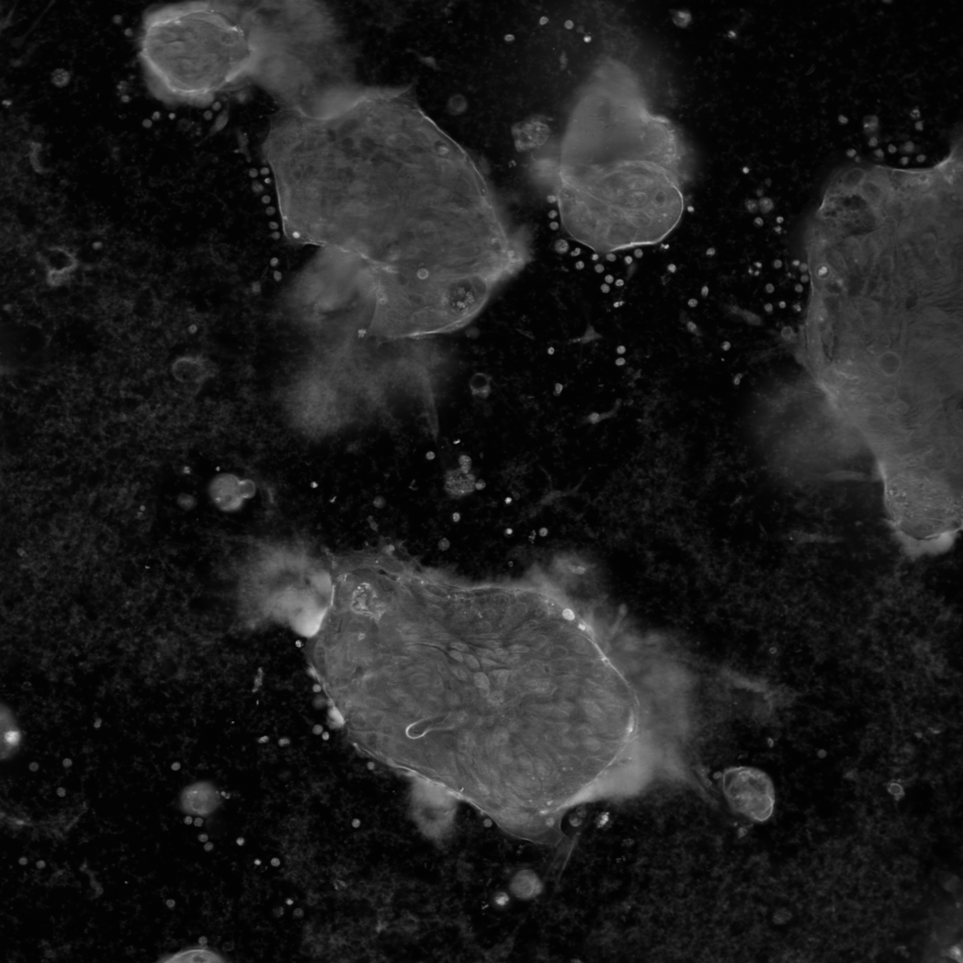
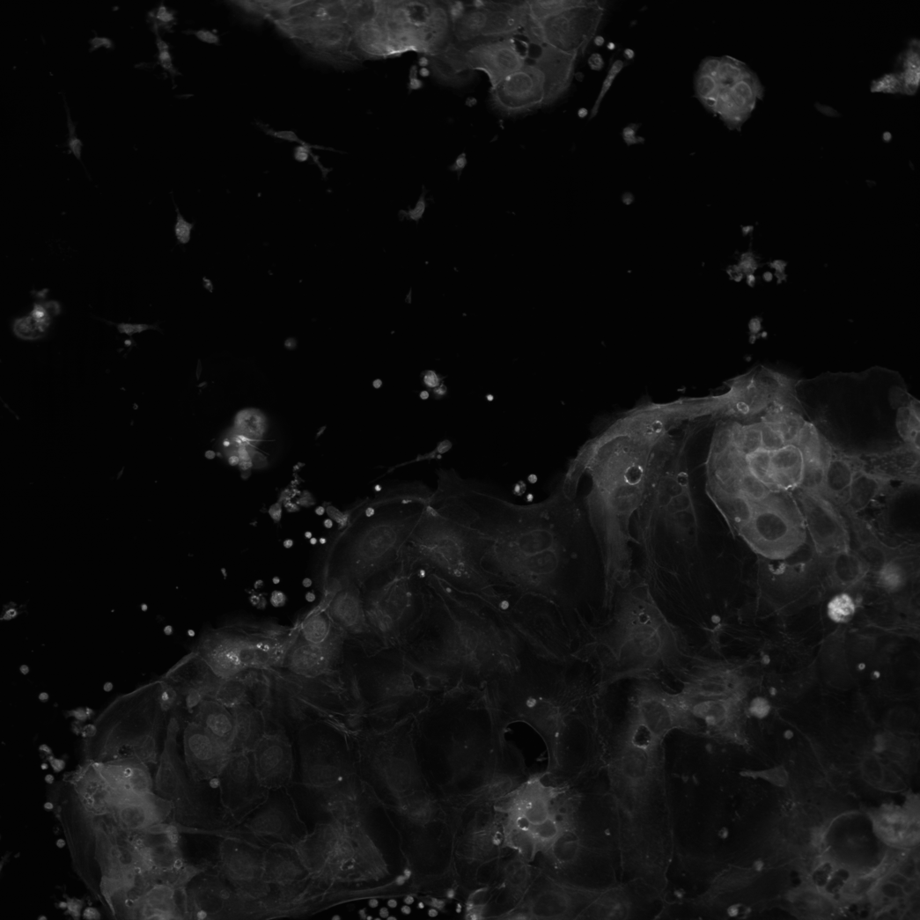
WP3 – next step: representation learning and segmentation
50% ENA-Nic / RPMI
50% ENA-Nic / RPMI
without hydrogel

Slide 9

WP3 Moving to a cloud native image analysis pipeline
Fully containerize organoid segmentation and phenotype-profiling
Complete Kubernetes deployment on denbi cloud infrastructure
Test single-cell resolution organoid benchmark dataset (e.g. cellpose)

Slide 10
WP3 On-going project specification
First engineering cycle completed: working automated liquid handling platform for a variety of PDO-PBMC engagement conditions established
We are entering the second iteration of the engineering cycle for WP3
Required: environment specifications for immune-cancer engagement studies
Tumor optimized medium conditions vs. leukocyte optimized conditions?
3D growth optimized conditions vs. leukocyte and imaging optimized conditions?

Slide 11
Overview of the original work plan

